Slide 1
Stack: Linked List Implementation
Push and pop at the head of the list
  New nodes should be inserted at the front of the list, so that they become the top of the stack
  Nodes are removed from the front (top) of the list
Straight-forward linked list implementation
  push and pop can be implemented fairly easily, e.g. assuming that head is a reference to the node at the front of the list
    public void push(int x){
      // Make a new node whose next reference is
      // the existing list
      Node newNode = new Node(x, top);
      top = newNode; // top points to new node
    }

Slide 2
List Stack Example
Java Code
Stack st = new Stack();
st.push(6);
top
6

Slide 3
List Stack Example
Java Code
Stack st = new Stack();
st.push(6);
st.push(1);
top
1
6

Slide 4
List Stack Example
Java Code
Stack st = new Stack();
st.push(6);
st.push(1);
st.push(7);
7
top
1
6

Slide 5
List Stack Example
Java Code
Stack st = new Stack();
st.push(6);
st.push(1);
st.push(7);
st.push(8);
8
7
top
1
6

Slide 6
List Stack Example
Java Code
Stack st = new Stack();
st.push(6);
st.push(1);
st.push(7);
st.push(8);
st.pop();
8
7
top
1
6

Slide 7
List Stack Example
Java Code
Stack st = new Stack();
st.push(6);
st.push(1);
st.push(7);
st.push(8);
st.pop();
7
top
1
6

Slide 8
Stack: ADT List Implementation
Push() and pop() either at the beginning or at the end of ADT List
  at the beginning:
  public void push(Object newItem) {
  list.add(1, newItem);
  } // end push
  public Object pop() {
  Object temp = list.get(1);
  list.remove(1);
  return temp;
  } // end pop
Notes:
Efficient if ADT List is implemented using Linked List.

Slide 9
Stack: ADT List Implementation
Push() and pop() either at the beginning or at the end of ADT List
  at the end:
  public void push(Object newItem) {
  list.add(list.size()+1, newItem);
  } // end push
  public Object pop() {
  Object temp = list.get(list.size());
  list.remove(list.size());
  return temp;
  } // end pop
Notes:
Efficient if ADT List is implemented using an array.

Slide 10
Stack: ADT List Implementation
Push() and pop() either at the beginning or at the end of ADT List
Efficiency depends on implementation of ADT List (not guaranteed)
On other hand: it was very fast to implement (code is easy, unlikely that errors were introduced when coding).

Slide 11
Applications of Stacks
Call stack (recursion).
Searching networks, traversing trees (keeping a track where we are).
Examples:
Checking balanced expressions
Recognizing palindromes
Evaluating algebraic expressions

Slide 12
Simple Applications of the ADT Stack: Checking for Balanced Braces
A stack can be used to verify whether a program contains balanced braces
  An example of balanced braces
    abc{defg{ijk}{l{mn}}op}qr
  An example of unbalanced braces
    abc{def}}{ghij{kl}m
    abc{def}{ghij{kl}m

Slide 13
Checking for Balanced Braces
Requirements for balanced braces
  Each time you encounter a “}”, it matches an already encountered “{”
  When you reach the end of the string, you have matched each “{”

Slide 14
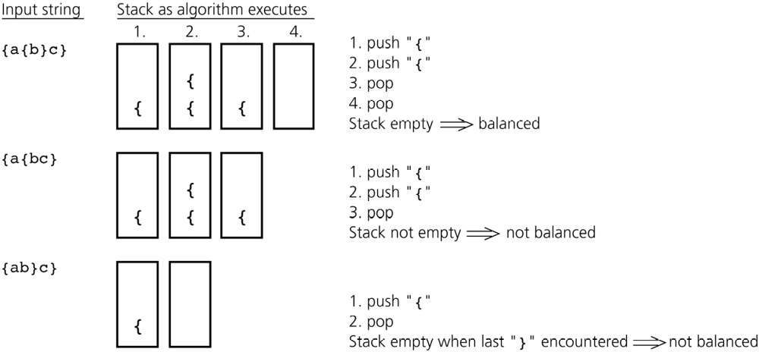
Checking for Balanced Braces
Figure 7-3
Traces of the algorithm that checks for balanced braces

Slide 15
Evaluating Postfix Expressions
A postfix (reverse Polish logic) calculator
  Requires you to enter postfix expressions
    Example: 2 3 4 + *
  When an operand is entered, the calculator
    Pushes it onto a stack
  When an operator is entered, the calculator
    Applies it to the top two operands of the stack
    Pops the operands from the stack
    Pushes the result of the operation on the stack

Slide 16
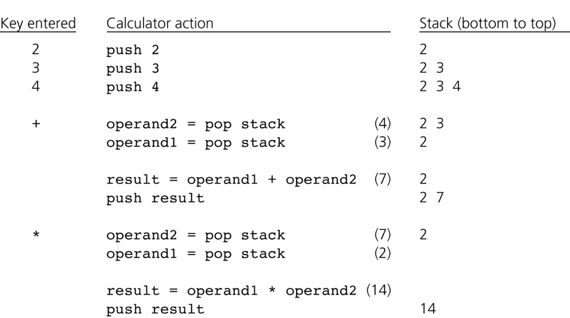
Evaluating Postfix Expressions
Figure 7-8
The action of a postfix calculator when evaluating the expression 2 * (3 + 4)

Slide 17
Evaluating Postfix Expressions
Pseudo code:
int evaluate(String expression)
{
Stack stack=new Stack(); // creaty empty stack
while (true) {
String c=expression.getNextItem();
if (c==ENDOFLINE)
return stack.pop();
if (c is operand)
stack.push(c);
else { // operation
int operand2=stack.pop();
int operand1=stack.pop();
stack.push(execute(c,operand1,operand2));
}
}
}

Slide 18
Queues
A queue is a data structure that only allows items to be inserted at the end and removed from the front
“Queue” is the British word for a line (or line-up)
Queues are FIFO (First In First Out) data structures – “fair” data structures

Slide 19

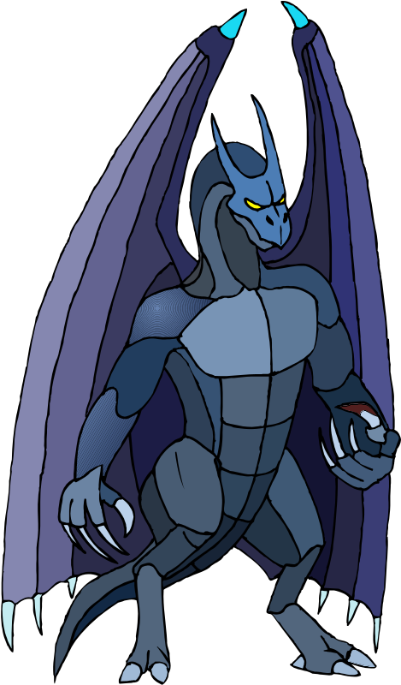




Using a Queue

Slide 20
What Can You Use a Queue For?
Processing inputs and outputs to screen (console)
Server requests
  Instant messaging servers queue up incoming messages
  Database requests
Print queues
  One printer for dozens of computers
Operating systems use queues to schedule CPU jobs
Simulations

Slide 21
Queue Operations
A queue should implement (at least) these operations:
  enqueue – insert an item at the back of the queue
  dequeue – remove an item from the front
  peek – return the item at the front of the queue without removing it
Like stacks it is assumed that these operations will be implemented efficiently
  That is, in constant time

Slide 22
Queue: Array Implementation
First consider using an array as the underlying structure for a queue, one plan would be to
  Make the back of the queue the current size of the queue (i.e., the number of elements stored)
  Make the front of the queue index 0
  Inserting an item can be performed in constant time
  But removing an item would require shifting all elements in the queue to the left which is too slow!
Therefore we need to find another way

Slide 23
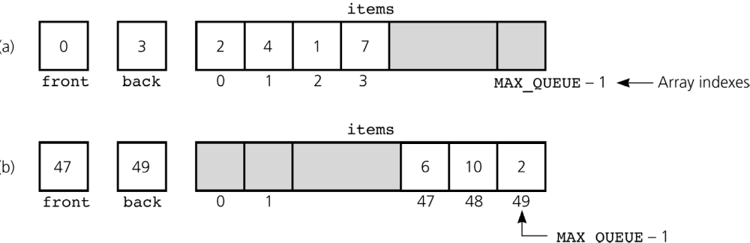
An Array-Based Implementation
Figure 8-8
a) A naive array-based implementation of a queue; b) rightward drift can cause the queue to appear full

